Slide 1
Unsupervised Learning
COMP6246: Machine Learning Technologies (MSc)
Dr Daniela Mihai (a-d.mihai@soton.ac.uk)
19th October 2026

Slide 2
Lecture Outline
By the end of this lecture, you will be able to
  Identify different types of Unsupervised Learning tasks
  Understand various Unsupervised Learning algorithms
    K-Means
    DBSCAN
    Gaussian Mixture Models
    And variants

Slide 3

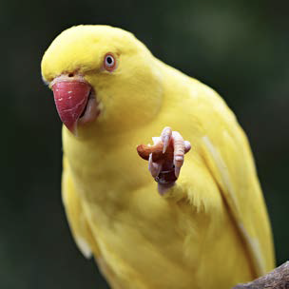


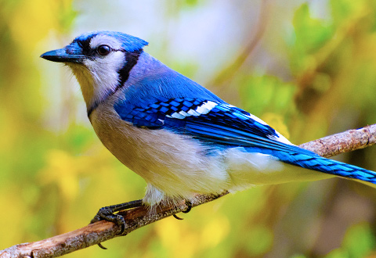
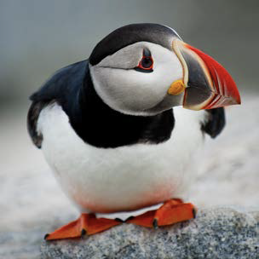
Unsupervised Learning
What happens when there are no labels?
Unsupervised Learning discovers patterns, structures or groupings in the data

Slide 4
Unsupervised Learning Tasks
Unsupervised Learning
  Learning from unlabeled data
Types of Unsupervised Learning Tasks
  Clustering – group similar instances together into clusters
    Image segmentation; Recommender systems
  Anomaly detection – learn what normal data looks like and then use that to detect abnormal instances
    Detecting defective items on a production line; new trend in a time series.
  Topic modelling – Uncovering abstract topics in documents
    Text mining; document classification

Slide 5
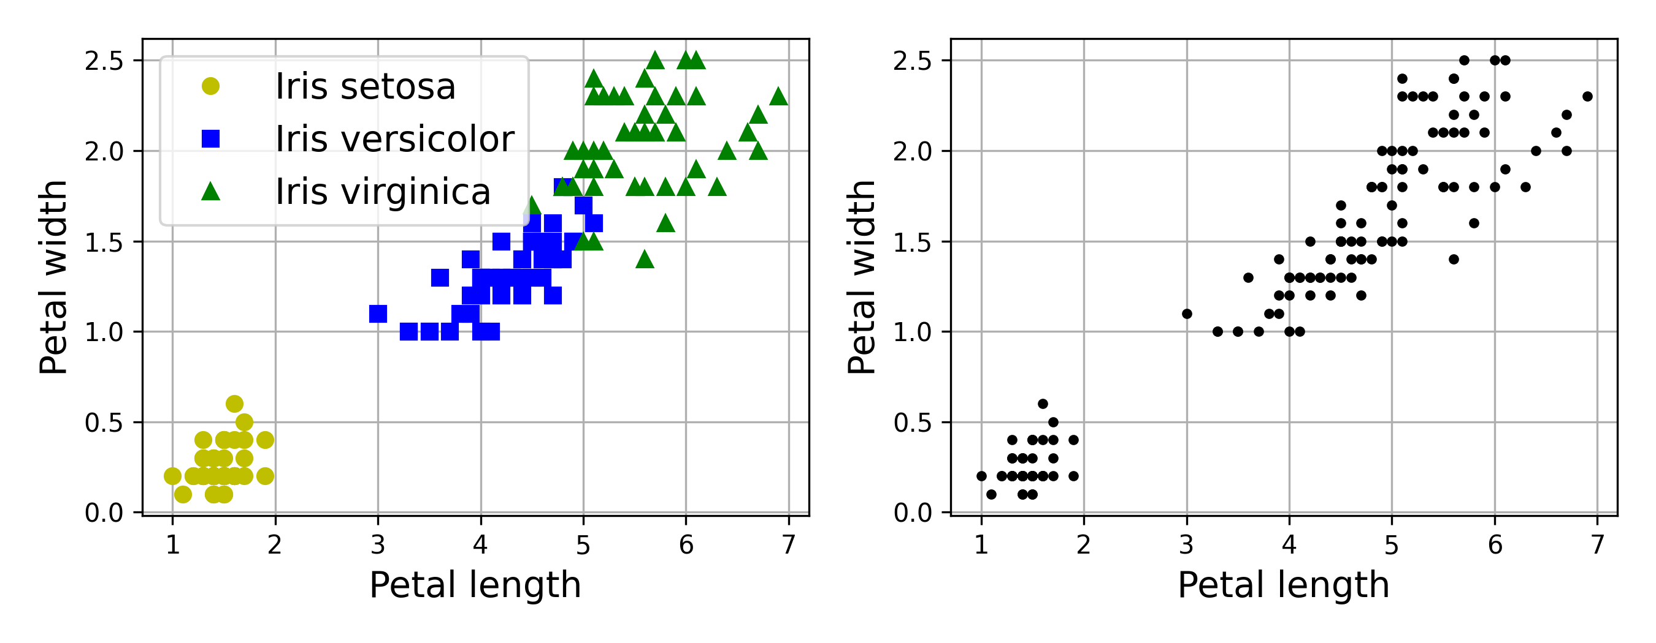
Clustering
Each instance in a dataset gets assigned to a group based on the features, but in an unsupervised fashion – without the guidance of labels.
No labels
How many classes are there?
Iris Dataset

Slide 6
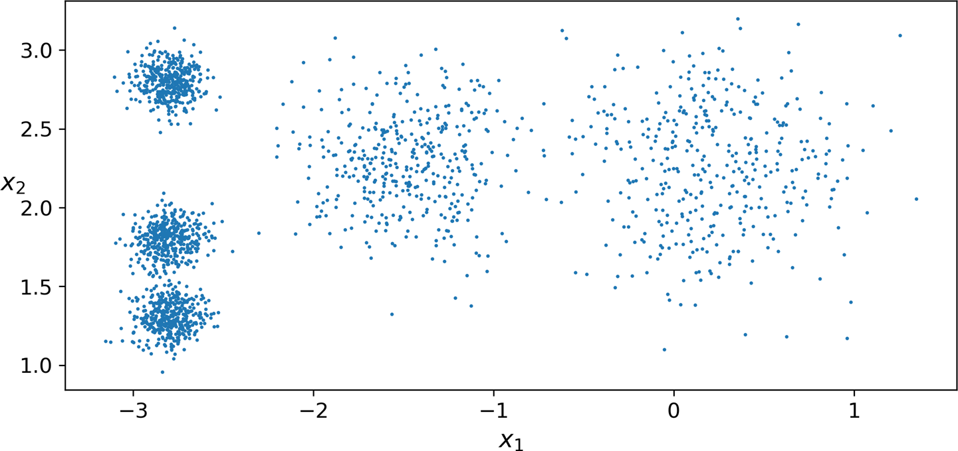
K-Means Clustering
K-Means algorithm
  will try to find each cluster’s center and
  assigns each instance to the cluster whose center is closest to that instance

Slide 7
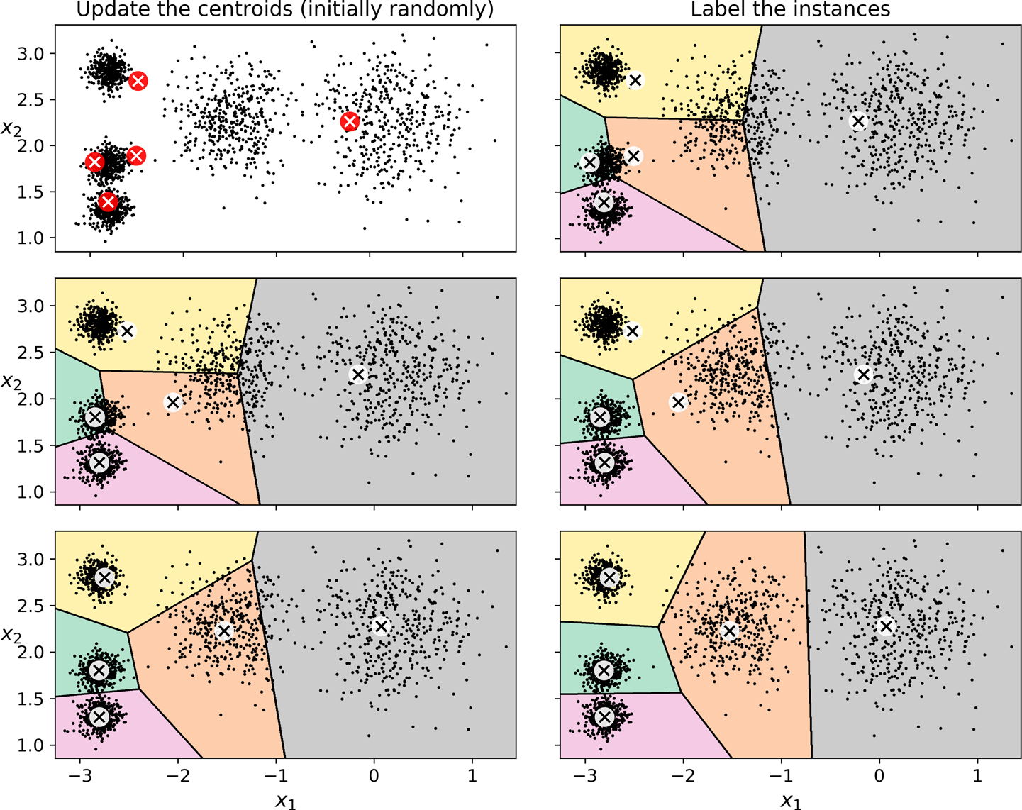
K-Means Algorithm
Where to start?
  You don’t have the labels or the locations of the centroids
  Just start by placing the centroids randomly
Then, iterate
  Label the instances based on the centroids
  Update the centroids based on the instances
  Repeat this until the centroids stop moving

Slide 8
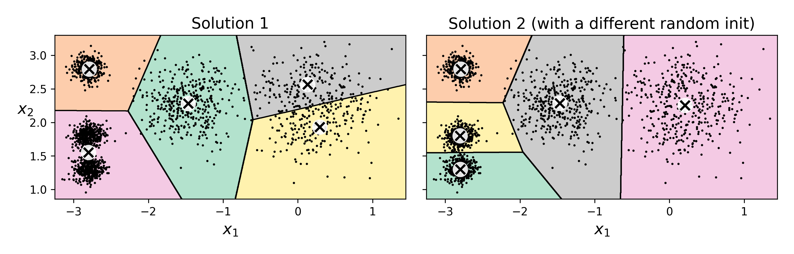
K-Means Algorithm – Convergence
Computational Complexity
  Generally linear with regard to the number of instances m, the number of clusters k, and the number of dimensions n.
  However, if the data does not have a good clustering structure, rarely, the complexity can raise exponentially with the number of instances.
The algorithms is not always guaranteed to converge
  High dependence on the random initialization
  May converge to local optimum

Slide 9
Improving Centroid Initialization
Some steps to try
  Prior knowledge – set good initial centroids
  Run the algorithm multiple times and keep the best solution
How do you measure performance?
  Inertia of the model
  Measures the mean-squared distance between each instance and its closest centroid
  Lower the inertia, better the model

Slide 10
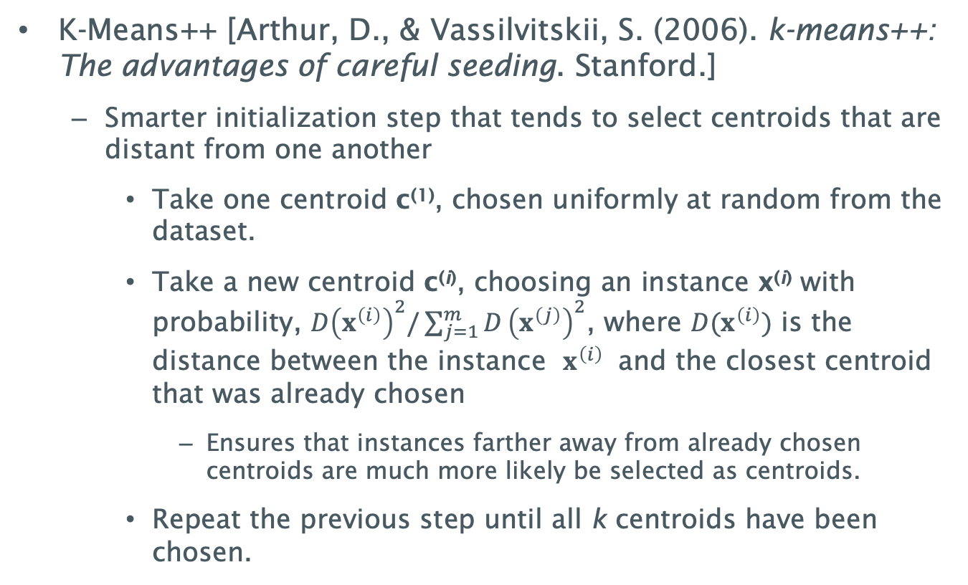
K-Means++
K-Means++ [Arthur, D., & Vassilvitskii, S. (2006). k-means++: The advantages of careful seeding. Stanford.]
  Smarter initialization step that tends to select centroids that are distant from one another
    Take one centroid c⁽¹⁾, chosen uniformly at random from the dataset.
    Take a new centroid c^{(i)}, choosing an instance x^{(i)} with probability, $D{\left(x^{\left(i\right)}\right)}^{2}/\sum_{j=1}^{m}{D}{\left(x^{\left(j\right)}\right)}^{2}$, where $D(x^{\left(i\right)})$ is the distance between the instance $x^{\left(i\right)}$ and the closest centroid that was already chosen
      Ensures that instances farther away from already chosen centroids are much more likely be selected as centroids.
    Repeat the previous step until all k centroids have been chosen.

Slide 11
Finding the optimal number of clusters
How do we know how many clusters are present in the data?
Can we pick the model with the lowest inertia?

Slide 12
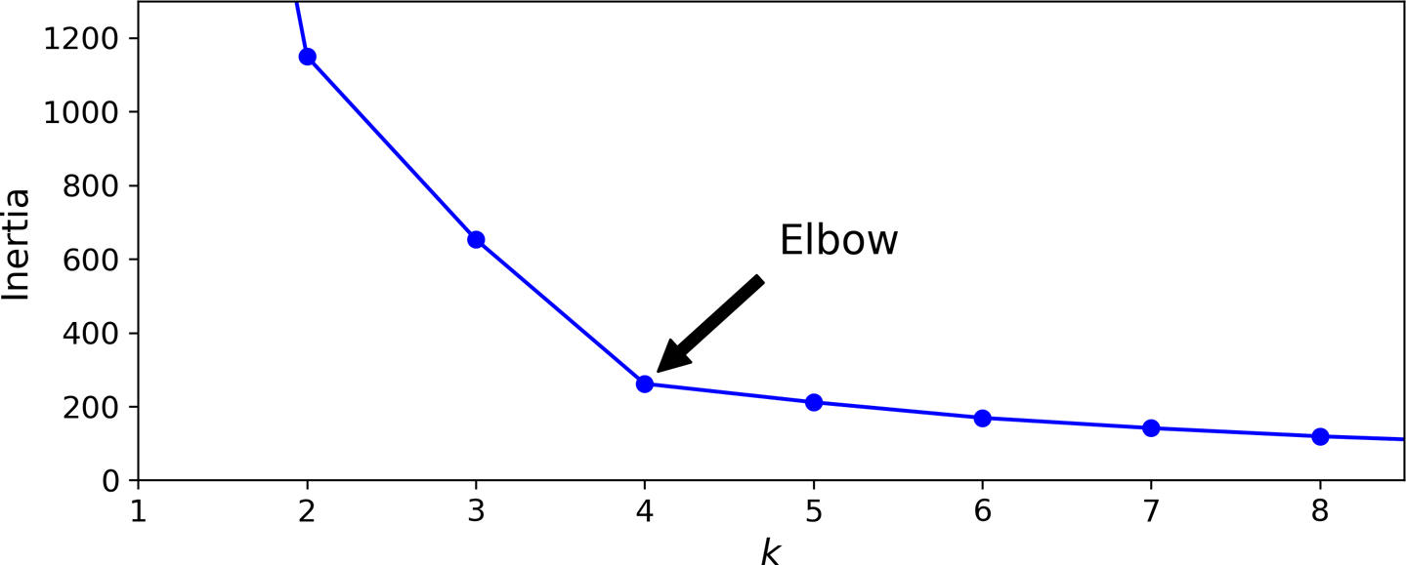
Using Inertia to choose k
Inertia is not a good metric when trying to choose k.
  Keeps getting lower as we increase k
  We may go with 4 as it seems like a sensible thing to choose the Elbow

Slide 13
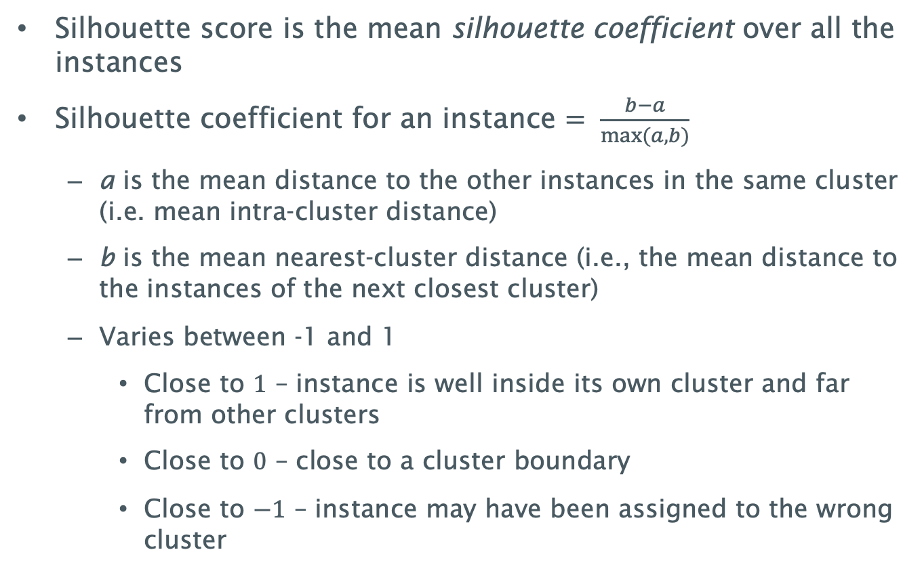
Silhouette score
Silhouette score is the mean silhouette coefficient over all the instances
Silhouette coefficient for an instance $= \frac{b−a}{max⁡(a,b)}$
  a is the mean distance to the other instances in the same cluster (i.e. mean intra-cluster distance)
  b is the mean nearest-cluster distance (i.e., the mean distance to the instances of the next closest cluster)
  Varies between -1 and 1
    Close to $1$ – instance is well inside its own cluster and far from other clusters
    Close to $0$ – close to a cluster boundary
    Close to $−1$ – instance may have been assigned to the wrong cluster

Slide 14
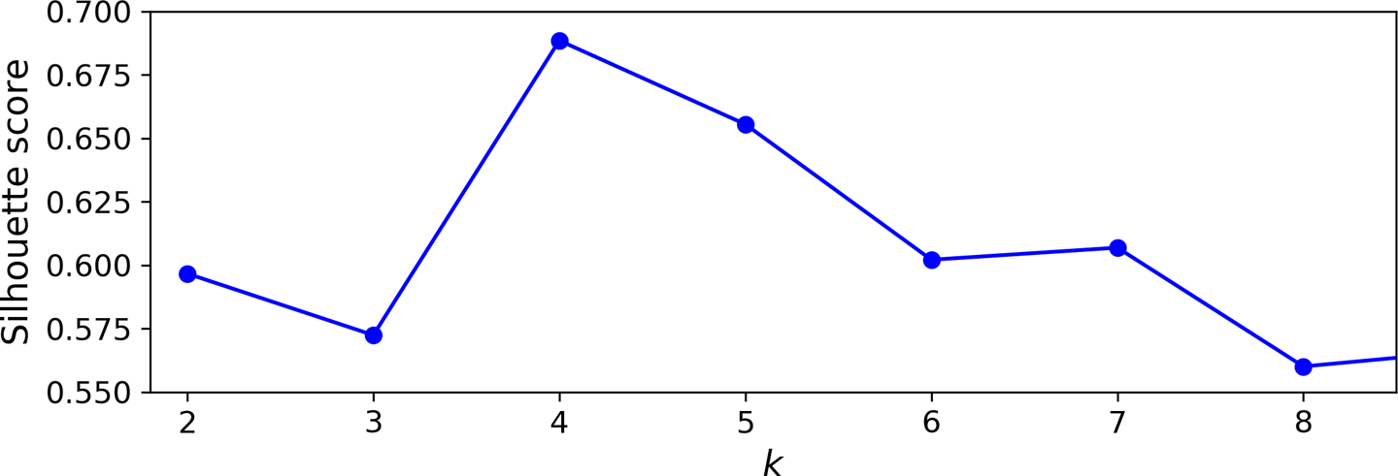
Silhouette score vs. k
Silhouette score for the example below

Slide 15
Silhouette score vs. k
Silhouette score for the example below
Limitations:
Quadratic time complexity
Favours convex, compact clusters

Slide 16
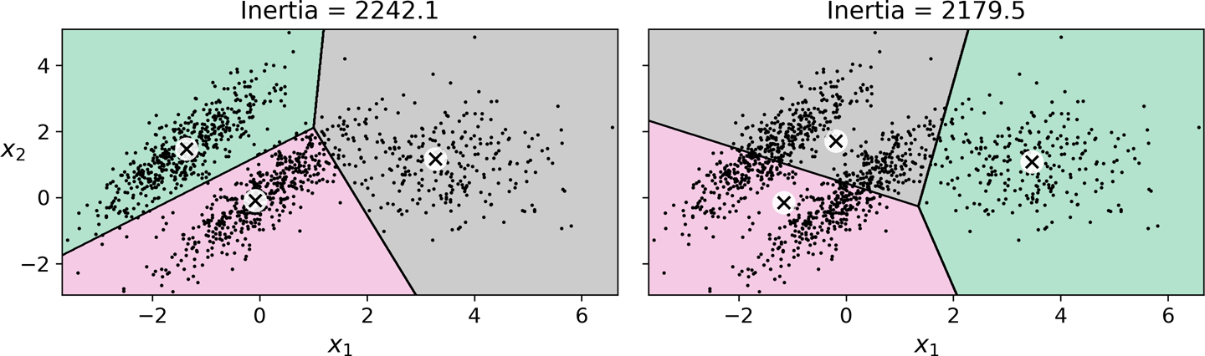
Limitations of K-Means
Despite being fast and scalable, K-Means has some limitations
  You may need to run the algorithm several times to avoid suboptimal solutions
  You need to specify the number of clusters
  K-Means does not behave very well when the clusters have varying sizes, different densities, or nonspherical shapes
K-Means fails to cluster ellipsoidal blobs properly

Slide 17
DBSCAN
DBSCAN is a very simple yet powerful algorithm capable of identifying any number of clusters of any shape.
DBSCAN defines clusters as continuous regions of high density.
For each instance, the algorithm counts how many instances are located within a small distance ε (epsilon) from it – called the instance’s ε-neighborhood.
If an instance has at least min_samples instances in its ε-neighborhood (including itself), it is considered a core instance. → core instances are those that are located in dense regions.
All instances in the neighborhood of a core instance belong to the same cluster. This neighborhood may include other core instances; therefore, a long sequence of neighboring core instances forms a single cluster.

Slide 18
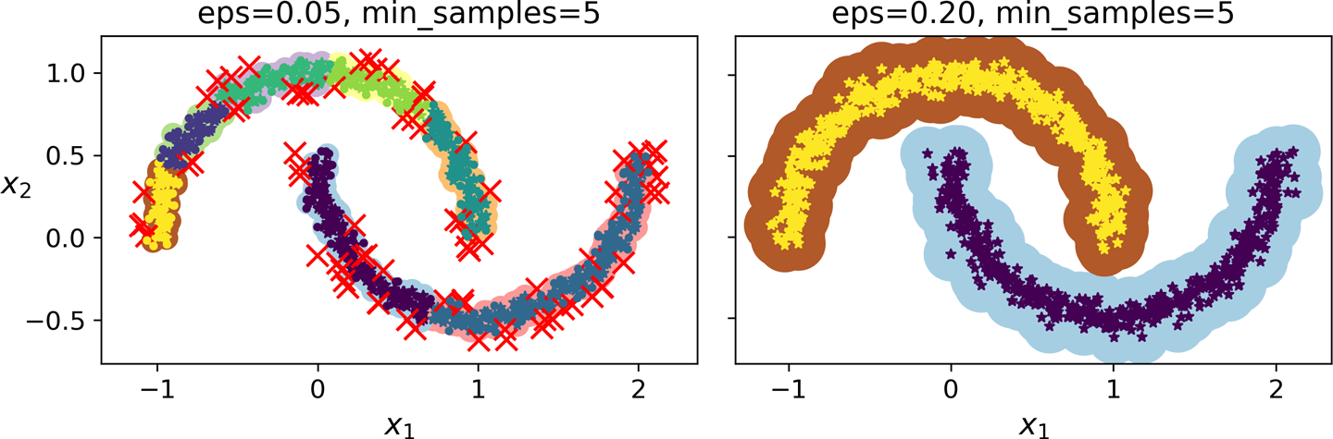
DBSCAN
Any instance that is not a core instance and does not have one in its neighborhood is considered an anomaly.
DBSCAN works well if all the clusters are dense enough and if they are well separated by low-density regions.
It has two hyperparameters – ε (epsilon) and min_samples
If the density varies significantly across the clusters, it can be impossible for it to capture all the clusters properly.

Slide 19
DBSCAN
A powerful algorithm that can identify any number of clusters of any shape.
Computational Complexity:
  O(m log m), indexed properly (e.g. spatially indexed using k-d tree)
  Can require O(m²) memory is eps is large;

Slide 20
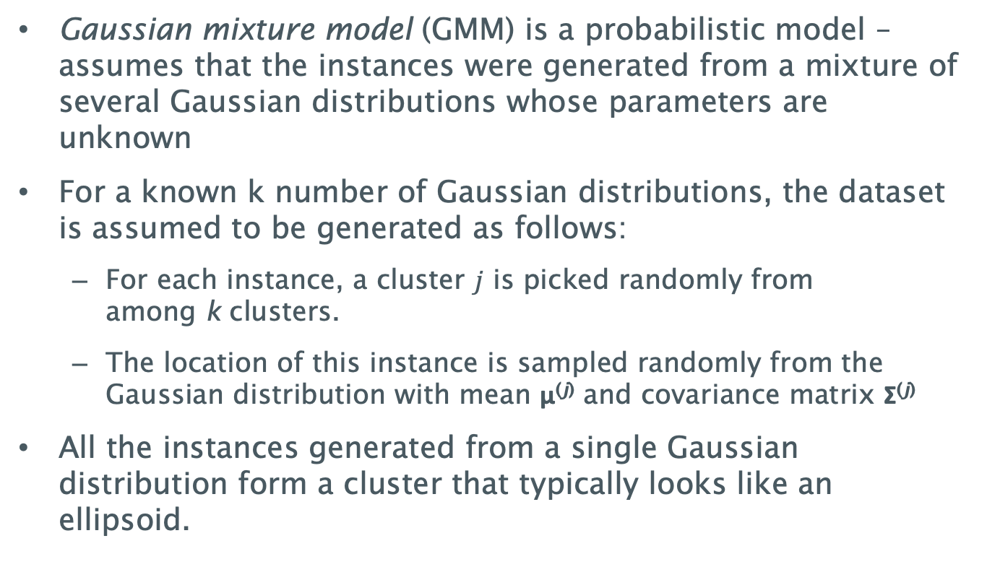
Gaussian Mixture Models
Gaussian mixture model (GMM) is a probabilistic model –assumes that the instances were generated from a mixture of several Gaussian distributions whose parameters are unknown
For a known k number of Gaussian distributions, the dataset is assumed to be generated as follows:
  For each instance, a cluster $j$ is picked randomly from among k clusters.
  The location of this instance is sampled randomly from the Gaussian distribution with mean μ^{(j)} and covariance matrix Σ^{(j)}
All the instances generated from a single Gaussian distribution form a cluster that typically looks like an ellipsoid.

Slide 21
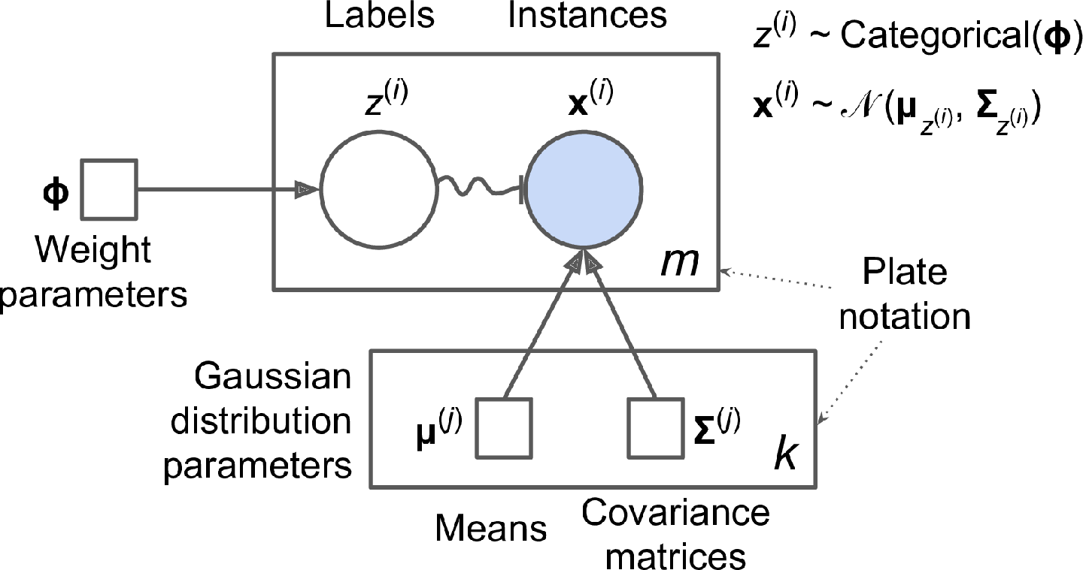
Data generation in GMMs
To train a GMM, given the dataset X, you want to estimate the weights ϕ and all the distribution parameters μ^{(j)} and Σ^{(j)}.

Slide 22
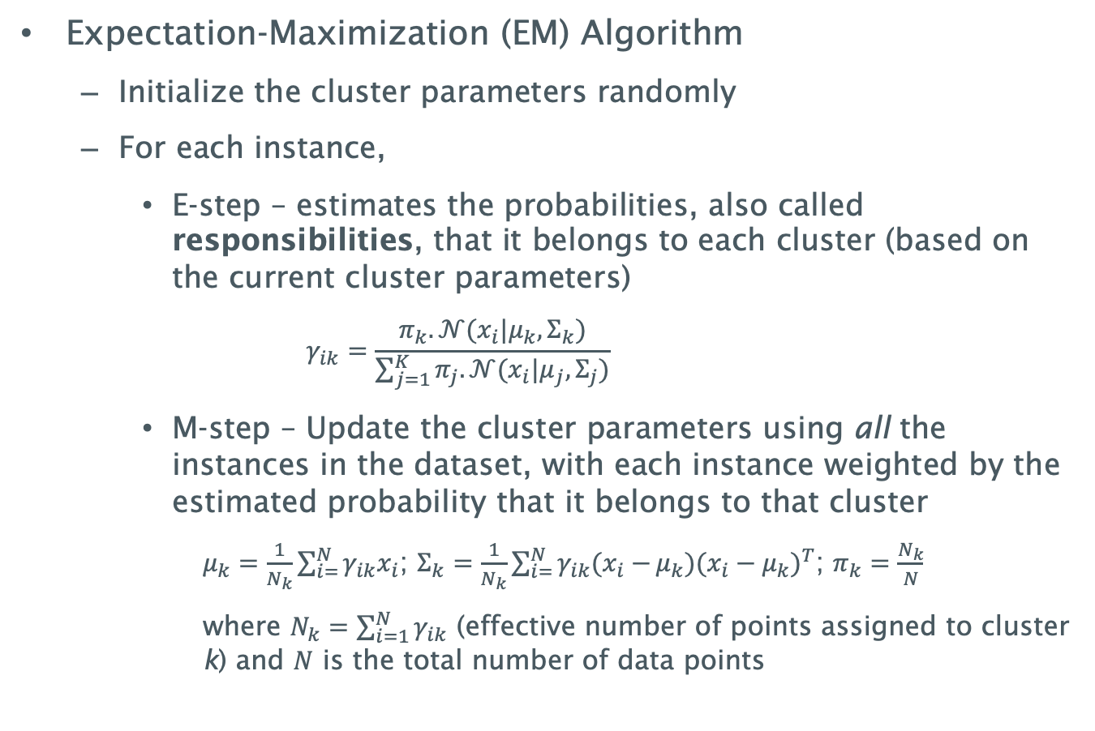
Training Gaussian Mixture Models
Expectation-Maximization (EM) Algorithm
  Initialize the cluster parameters randomly
  For each instance,
    E-step – estimates the probabilities, also called responsibilities, that it belongs to each cluster (based on the current cluster parameters)
      $$γ_{ik}=\frac{π_{k}.𝒩(x_{i}|μ_{k},Σ_{k})}{\sum_{j=1}^{K}{π_{j}.𝒩(x_{i}|μ_{j},Σ_{j})}}$$
    M-step – Update the cluster parameters using all the instances in the dataset, with each instance weighted by the estimated probability that it belongs to that cluster
      $μ_{k}=\frac{1}{N_{k}}\sum_{i=}^{N}{γ_{ik}x_{i}}$; $Σ_{k}=\frac{1}{N_{k}}\sum_{i=}^{N}{γ_{ik}(x_{i}−}μ_{k}){(x_{i}−μ_{k})}^{T}$; $π_{k}=\frac{N_{k}}{N}$
      where $N_{k}=\sum_{i=1}^{N}{γ_{ik}}$ (effective number of points assigned to cluster k) and $N$ is the total number of data points

Slide 23
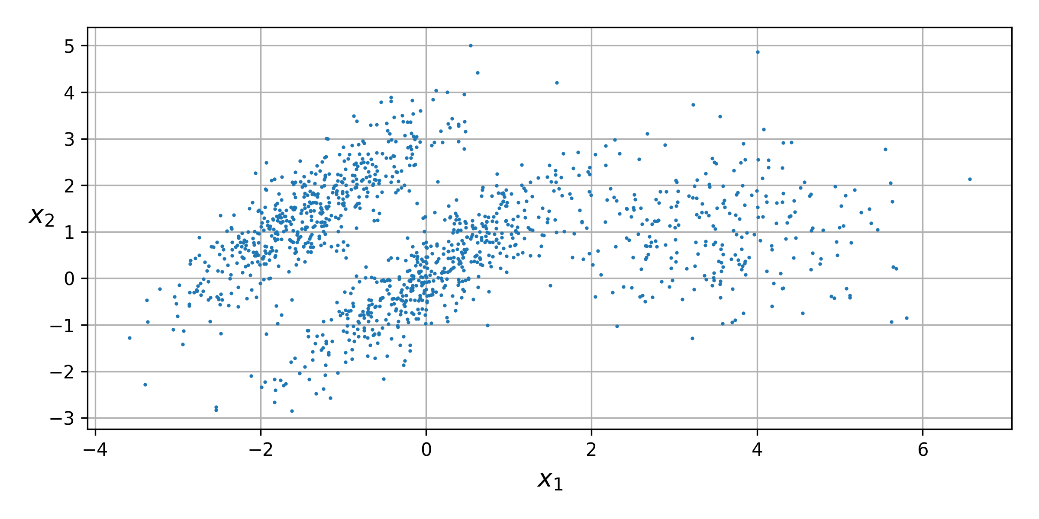
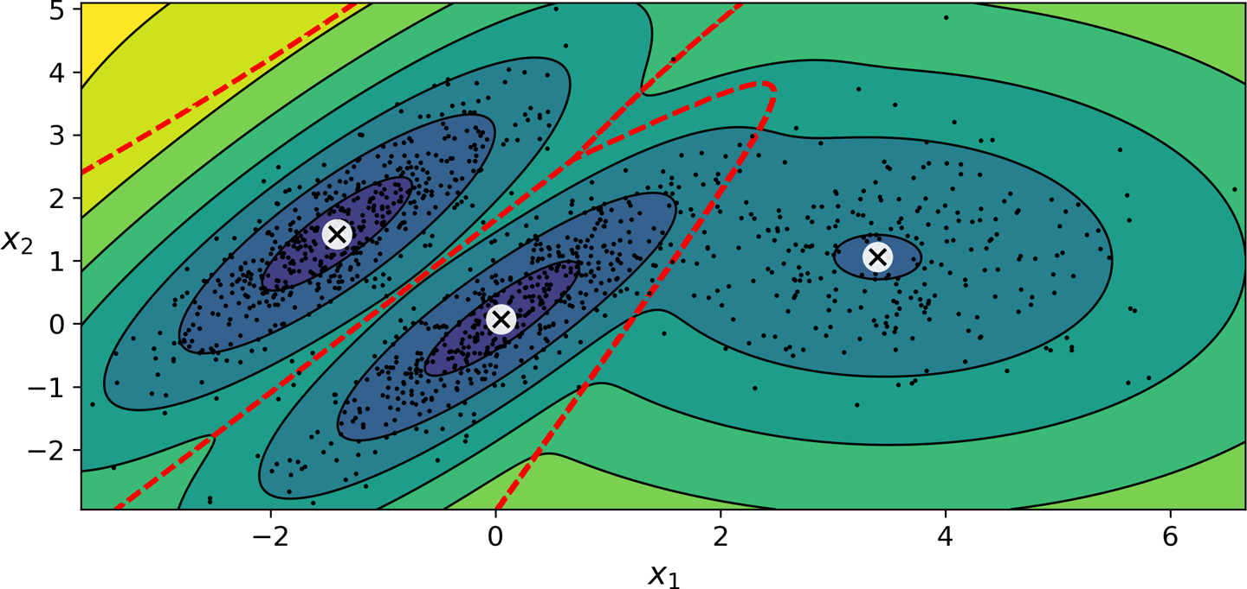
Visualizing GMMs
Dataset with elongated blobs and varying densities
Cluster means, decision boundaries, and density contours of a trained Gaussian mixture model

Slide 24
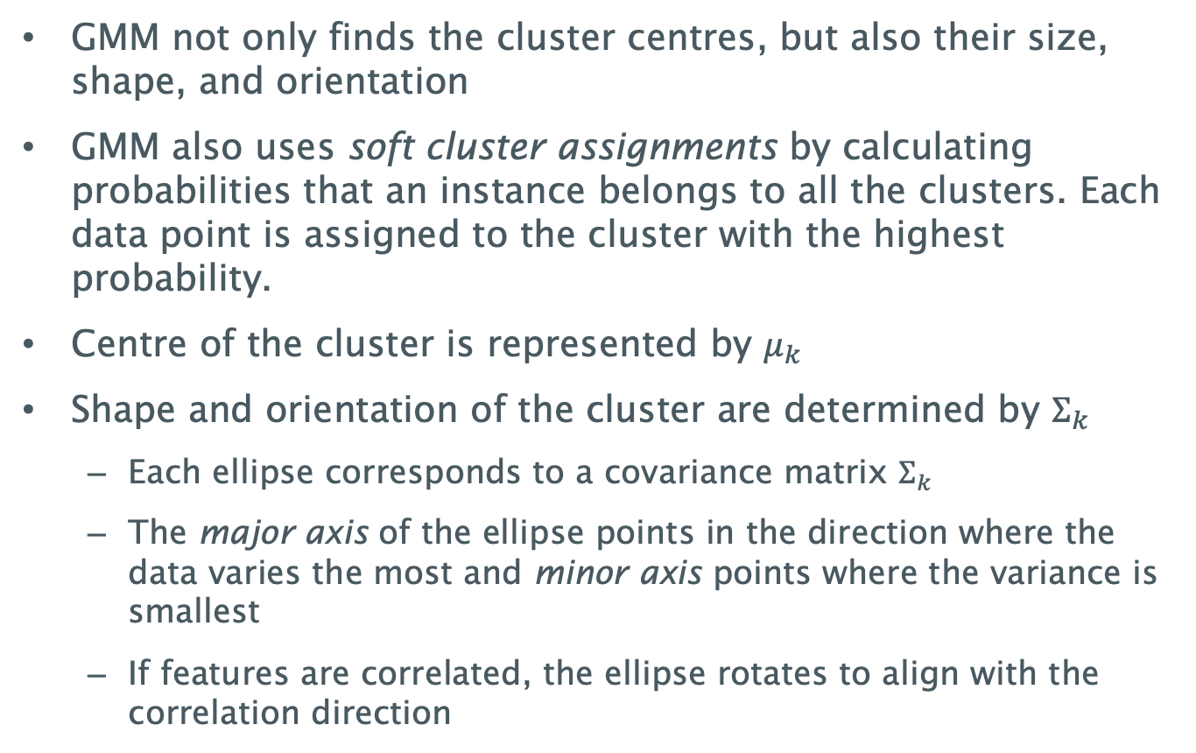
GMM output – things to note
GMM not only finds the cluster centres, but also their size, shape, and orientation
GMM also uses soft cluster assignments by calculating probabilities that an instance belongs to all the clusters. Each data point is assigned to the cluster with the highest probability.
Centre of the cluster is represented by $μ_{k}$
Shape and orientation of the cluster are determined by $Σ_{k}$
  Each ellipse corresponds to a covariance matrix $Σ_{k}$
  The major axis of the ellipse points in the direction where the data varies the most and minor axis points where the variance is smallest
  If features are correlated, the ellipse rotates to align with the correlation direction

Slide 25
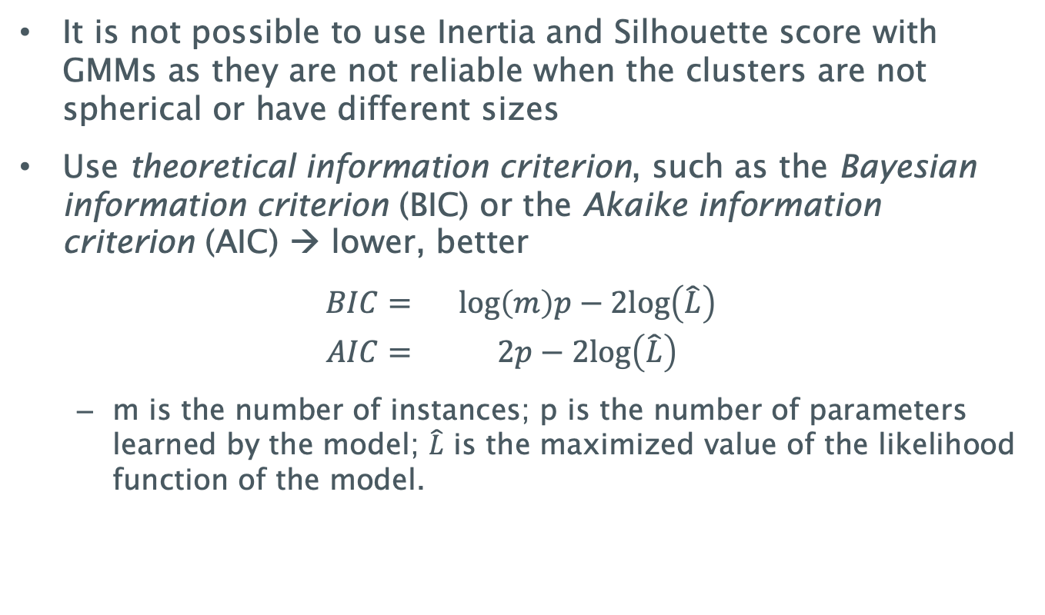
Selecting the Number of Clusters
It is not possible to use Inertia and Silhouette score with GMMs as they are not reliable when the clusters are not spherical or have different sizes
Use theoretical information criterion, such as the Bayesian information criterion (BIC) or the Akaike information criterion (AIC) → lower, better
$$\begin{matrix}BIC= & log\left(m\right)p−2log\left(\hat{L}\right) \\ AIC= & 2p−2log\left(\hat{L}\right)\end{matrix}$$
  m is the number of instances; p is the number of parameters learned by the model; $\hat{L}$ is the maximized value of the likelihood function of the model.

Slide 26
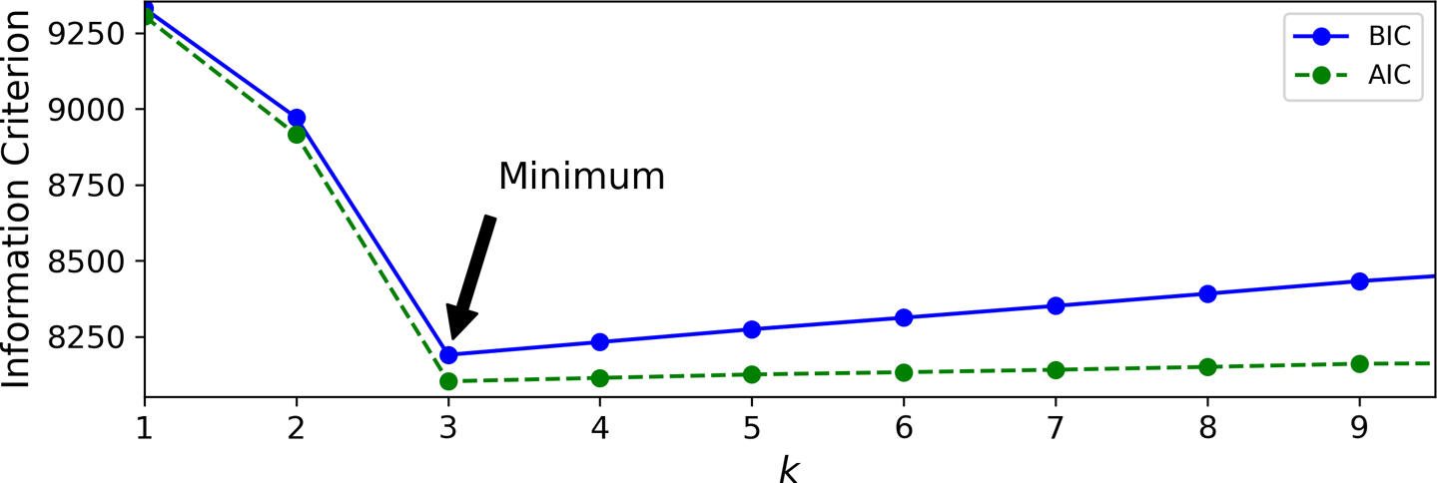
Selecting the Number of Clusters
Both BIC and AIC penalize models that have more parameters to learn (e.g., more clusters) and reward models that fit the data well.
They often select the same model. When they differ, the model selected by the BIC tends to be simpler (fewer parameters) but tends to not fit the data quite as well (especially for larger datasets).
Comparing BIC and AIC for the 3 elliptical blobs dataset

Slide 27
Summary
We looked at Unsupervised Learning Techniques – K-Means, DBSCAN and GMMs
 | K-Means | DBSCAN | GMMs
Algorithm Type | Centroid-based | Density-based | Probabilistic
Clusters | Spherical | Arbitrary | Elliptical
Predefined k | Yes | No | Yes
Handling Outliers | No | Yes | No
Usecases | Well-separated spherical clusters | Spatial data, anomaly detection | Soft clustering, overlapping clusters

Slide 28
Next Lecture: Dimensionality Reduction
Questions?

